Slide 1
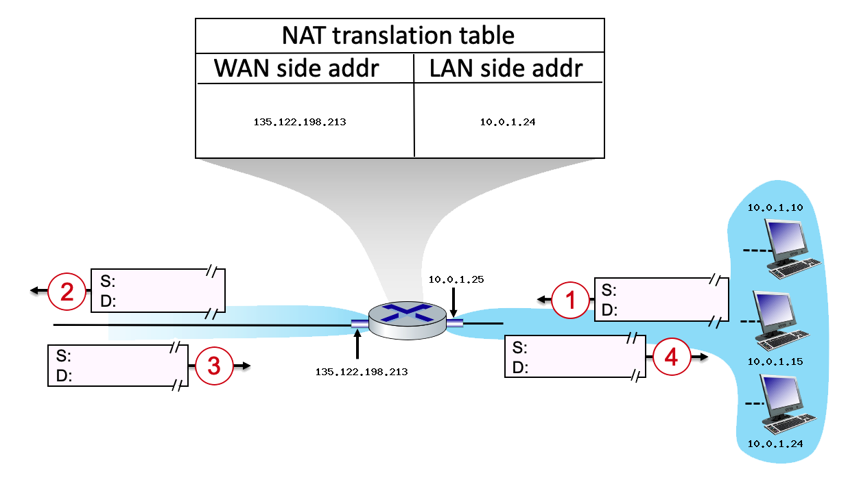
NETWORK ADDRESS TRANSLATION
Suppose that the host with IP address 10.0.1.24 sends an IP datagram destined to host 128.119.173.184. The source port is 3436, and the destination port is 80.

